Slide 1
The Impact of Homeless Prevention on Children Residential Instability
GABRIEL PIÑA
CHILD TRENDS
gpina@childtrends.org

Slide 2
CONTEXT
“Both the federal government and communities have invested heavily in permanent supportive housing (PSH) over the last decade. The PSH inventory grew 88 percent between 2007 and 2017, and the inventory dedicated to people with chronic patterns of homelessness grew 294 percent (and 34% just since 2016).”
“The steady declines in the number of people experiencing homelessness in families with children can be attributed, in part, to federal and local investments in rapid rehousing programs.”
Source: HUD, The 2018 Annual Homeless Assessment Report (AHAR) to Congress.

Slide 3
CONTEXT
The number of homeless students has increased significantly in the last 10 years. Approximately 1.5 million students are homeless.
Number of Students (in Thousands), Ages 6-18, who were Homeless. By Living Situation: School Years 2004-05 to 2013-14
Around seven million people were doubled up with family and friends, the most common prior living situation before becoming homeless.
Poor households living doubled up is 52 percent higher now than in 2007 (National Alliance to End Homelessness)
Total
Doubled up
Shelters
Hotel/Motel
Unsheltered
Not reported
Source: Child Trends, data from National Center for Homeless Education.

Slide 4
CONTEXT
These counts include people who are temporarily sheltered (those who are living in emergency shelters, transitional housing programs, or put up in motels through a social service program).

Slide 5
CONTEXT
The age at which a person is most likely to be found in a homeless shelter in the United States is infancy.
Annual Percentage Rates of Shelter Use By Age (National)
Source: Annual Homeless Assessment Report to Congress and Census Bureau

Slide 6
CONTEXT
Children who lack a stable home are vulnerable to a number of adverse outcomes (Child Trends DataBank 2015)
Homeless children develop moderate to severe acute and chronic health problems, and less access to medical and dental care. (Bassuk et al., 1997; Buckner, 2008; Haveman et al. 1991; Mohanty & Raut, 2009).
Unpredictable and undesired moves from one’s home negatively influence children’s development and well-being (Grant et al., 2013; Buckner, 2008).
Children experiencing residential instability show lower vocabulary skills, more behavioral problems, increased high school drop-out rates, and lower adult educational attainment, when compared to children living in stable households (Sandstrom & Huerta, 2013).

Slide 7
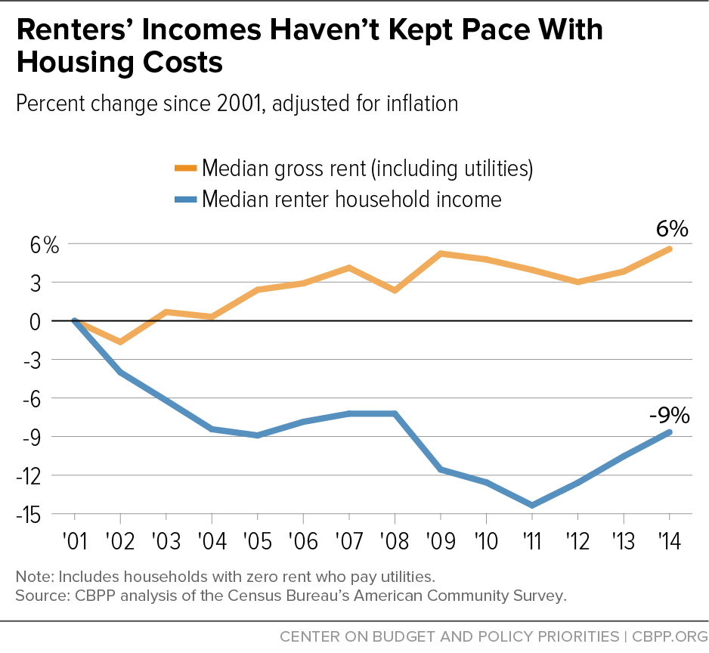
CONTEXT
While renters are becoming poorer, the supply of housing that is affordable and available is shrinking.

Slide 8
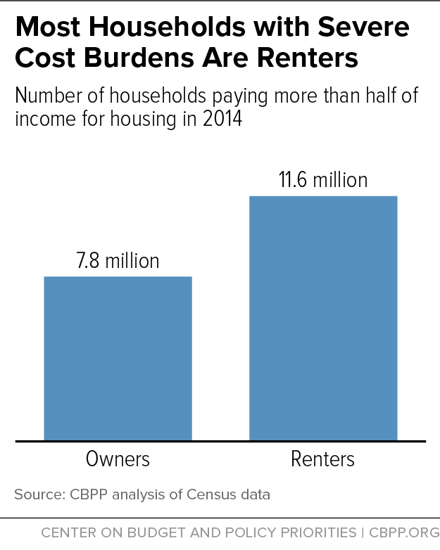
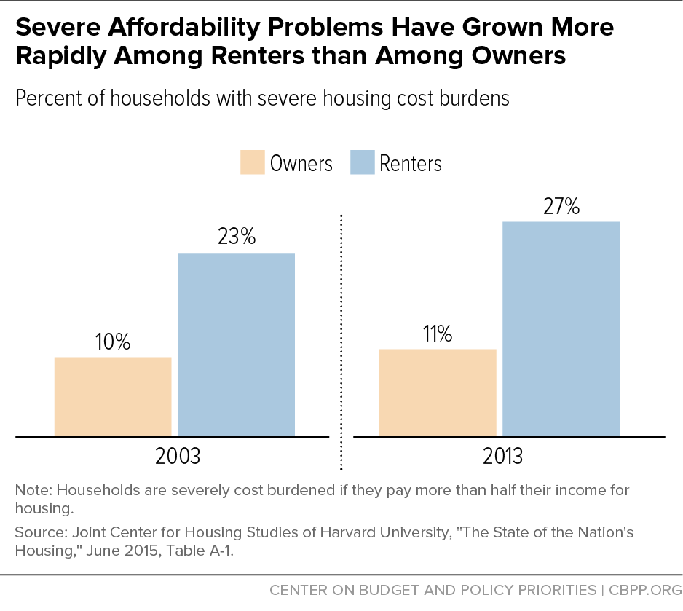
CONTEXT
The median asking rent on new apartments was $1,381 per month in 2015, well out of
reach for the typical renter earning $35,000 a year.

Slide 9
CONTEXT: POLICIES
Type of Prevention | Does it prevent homelessness? | Does it improve outcomes?
Primary Prevention Universally available programs such as affordable housing or vouchers. | Yes | Yes (family preservation, domestic violence, stress, substance abuse, school attendance).
Secondary programs Rapid rehousing, transitional housing, or homeless prevention (financial assistance), seek to identify and end an episode of homelessness very quickly. | Rapid-rehousing: Conflicting (more likely “No”) Homeless Prevention: Some evidence Transitional Housing: Mostly Yes | Rapid-rehousing: No impact (but only one study). Homeless Prevention: No studies Transitional Housing: Some evidence in children’s outcomes.
Tertiary programs Target long-term homelessness or housing problems, aiming to reduce the impacts of longer term housing needs. | Yes | Conflicting evidence.

Slide 10
HOMELESSNESS PREVENTION
There has been a “redirection in the nation’s homelessness assistance policies” (Culhane, Metraux, and Byrne, 2011).
Homelessness prevention policies are still in their infancy and there is little scientific knowledge for its implementation. (Apicello 2010).
Long-term commitment to homelessness prevention has been evident in the United Kindom, Germany, and Finland, where primary prevention is approached as expanded access to housing and a serious response to family homelessness (Fitzpatrick, Johnsen, & Watts, 2012; Szeintuch, 2017).

Slide 11
HOMELESSNESS PREVENTION
New York City’s Homebase: Family shelter entries decreased on average in 5-11 percent the neighborhoods in which Homebase was operating. (Goodman et al. 2016).
Chicago’s Homelessness Prevention Call Center: Individuals requesting assistance when funding is available are 76% less likely to enter a homeless shelter (Evans, Sullivan and Walskog 2016)
Family Options Study is the largest experimental study of housing interventions of varying intensity. No significant differences in outcomes between rapid-rehousing and shelter care (Gubits et al. 2016). Significant differences between vouchers and shelters.

Slide 12

THE HOMELESS PREVENTION AND RAPID RE-HOUSING PROGRAM
The first ever large-scale homelessness prevention program in U.S. history ($1.5 billion). Started in September 2009 and lasted for three years.
Largely targeted individuals who were not necessarily homeless or living in a shelter, but at risk of becoming homeless.
Activities:
Financial assistance (such as rental assistance,
utility deposits, and moving costs assistance).
Housing relocation and stabilization services
(such as case management, outreach, legal
services, and housing search).
Data collection and evaluation.
Administrative costs (capped at 5 percent
of the grants)

Slide 13
DATA AND ANALYSIS
Homeless student counts for 26 states and 5,148 public school districts from school years 2005-06 to 2013-2014.
No common definition for the concept of residential instability (Cotton & Schwartz-Barcott, 2016; Priester, Foster, & Shaw, 2016).
Most authors would agree that housing instability is at least an antecedent to homelessness (Cunningham, Harwood, & Hall, 2010; Priester, Foster, & Shaw, 2016).
Previous research has recognized different forms of housing instability, such as moving frequently, foreclosure, doubling up, episodic homelessness, or moving because of housing costs (Priester, Foster, & Shaw, 2016; Gilman et al., 2003).

Slide 14
DATA AND ANALYSIS
These states account for 850,00 homeless students, or 67% of the homeless population in 2014.
Percentage of homeless students 2013-14
Source: Institute for Children, Poverty and Homelessness, and National Center for Homeless Education.

Slide 15
DATA AND ANALYSIS
Homeless students per 100 students in states with and without data available for the period. School years 2006-07 to 2013-14.
Source: Institute for Children, Poverty and Homelessness, and National Center for Homeless Education.

Slide 16
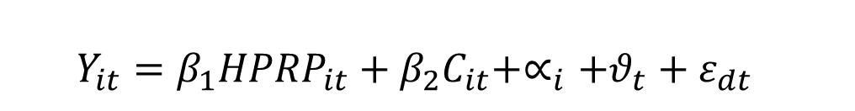
DATA AND ANALYSIS
$Y_{it}=β_{1}{HPRP}_{it}+β_{2}C_{it}+∝_{i}+θ_{t}+ε_{dt}$
for district i, and school year t.
School years 2005-2006 to 2013-2014.
𝑌_{it}: the percentage of students counted as homeless in district i.
HPRP_{it}:
Dummy for districts with an HPRP provider in the county.
Dummy for districts within 10 miles of an HPRP provider.
Dummy for districts within 20 miles of an HPRP provider.
District fixed effects (α) and School year fixed effects (ϑ).
C_{it} is a vector of time-variant district-level controls: Neighborhood Stabilization Fund, TANF Emergency, Unemployment rate, Rent Costs, Students in Free Lunch, Non-white Students, Households Renting (%).

Slide 17
THREATS TO VALIDITY
Perhaps the biggest concerns with any identification strategy are the threats to internal validity is this really causal?
For instance, if the money was allocated to poorer communities, these communities may implement other policies or strategies to palliate the effects of the recession. Upward Bias
Similarly, if the money was allocated to poorer communities, these communities may have budgetary problems and cut other programs to address the effects of the recession. Downward Bias

Slide 18
HPRP ALLOCATION
The HPRP distributed the federal funding in a grant format to 535 states, urban counties, metropolitan cities, and U.S. territories based on the Community Development Block Grant Formula.
CDBG: Heavy weight on Population and Number of Poor Individuals.

Slide 19
HPRP ALLOCATION
As a consequence, the money did not always target the places in most need.
Unemployment rate (%) in each school district’s county in 2009
Model 1
Model 2
Model 3

Slide 20
HPRP ALLOCATION
As a consequence, the money did not always target the places in most need.
Students’ Homeless rate (%) in each school district in 2008-09
Model 1
Model 2
Model 3

Slide 21
HPRP ALLOCATION
The funds did target larger communities.
Average number of students in each school district in school year 2008-09
Model 1
Model 2
Model 3

Slide 22
DATA AND ANALYSIS
$Y_{it}=β_{1}{HPRP}_{it}+β_{2}C_{it}+∝_{i}+θ_{t}+ε_{dt}$
for district i, and school year t.
School years 2005-2006 to 2013-2014.
𝑌_{it}: the percentage of students counted as homeless in district i.
HPRP_{it}:
Dummy for districts with an HPRP provider in the county.
Dummy for districts within 10 miles of an HPRP provider.
Dummy for districts within 20 miles of an HPRP provider.
District fixed effects (α) and School year fixed effects (ϑ).
C_{it} is a vector of time-variant district-level controls: Neighborhood Stabilization Fund, TANF Emergency, Unemployment rate, Rent Costs, Students in Free Lunch, Non-white Students, Households Renting (%).

Slide 23
DATA AND ANALYSIS
DESCRIPTIVE STATISTICS
School years 2005-2006 to 2013-2014.

Slide 24
FALIFICATION TESTS
Falsification Tests (Pre-Trend analysis)
Clustered Robust Standard Errors in parenthesis *** p<0.01, **p<0.05, *p<0.1

Slide 25
DATA AND ANALYSIS
RESULTS
Dependent Variable: Percentage of Homeless Students in a School District.
School Years 2005-2006 to 2013-2014.
Mean Dependent Variable Pre HPRP 1.6 1.6 1.6
Clustered Robust Standard Errors in parenthesis *** p<0.01, **p<0.05, *p<0.1

Slide 26
FALSIFICATION TESTS
The effect dissipates as the distance increases.
Clustered Robust Standard Errors in parenthesis *** p<0.01, **p<0.05, *p<0.1

Slide 27
FURTHER ANALYSIS
School District models in Counties with more 30% of households renting. Years 2005-2006 to 2012-2013.
Mean Dependent Variable 2.14 2.14 2.14
Clustered Robust Standard Errors in parenthesis *** p<0.01, **p<0.05, *p<0.1

Slide 28
FURTHER ANALYSIS
Do the effects last after the program ends?
Clustered Robust Standard Errors in parenthesis *** p<0.01, **p<0.05, *p<0.1
Additional models with restricted and weighted sample showed similar results

Slide 29
CONCLUSIONS
Children who lack a stable home are vulnerable to a number of adverse outcomes.
The number of families at risk being residentially unstable has increased in later years.
Recent focus on Rapid-rehousing and Supportive housing may explain the decrease in homelessness in the U.S.
However, we the little evidence we have shows that these programs may promote positive outcomes as we would expect.

Slide 30
CONCLUSIONS
This study shows that homeless prevention programs can reduce residential instability in at least 8 percent.
Previous studies have focused on New York and Chicago, which have their unique context and programs.
Whereas the Family Options study provides evidence about the capacity of homeless prevention programs to lift families out of shelters, this study provides evidence about the impact of prevention programs on actually preventing homelessness and residential instability.
In a context where rising numbers of low-income families struggle to pay rent, and expenditures on programs such as Section 8 or Public Housing falling over the last few years, homelessness prevention can provide a cost effective alternative to reduce the negative impacts of residential instability, even if only temporarily.

Slide 31
THREATS TO VALIDITY
Previous research shows that the spatial accessibility of service providers is an important determinant of service utilization among welfare recipients (Allard, Tolman & Rosen, 2003).
Low-income families face limitations of public transportation systems and low car ownership rates (Herbst & Tekin, 2016).
Distance to intake agencies may serve as a proxy for increased transaction costs and reduced information sharing for potential beneficiaries in housing and health policies (Rusell et al. 2014; Andersen 1995; Collinsand Schmeiser; 2013).
A qualitative study by HUD (2016) shows that in many cases potential program participants of HPRP were not aware of the program.

Slide 32
CDBG FORMULA
${Funding}_{i}=β_{1}{Pre1940Housing}_{i}+β_{2}C_{i}+β_{3}X_{i}+∝_{i}+ε_{i}$
${Homelessness rate}_{i}=β_{1}{Funding}_{i}+β_{2}C_{i}+β_{3}X_{i}+∝_{i}+ε_{i}$

